Slide 1
Naïve Bayes Classification

Slide 2
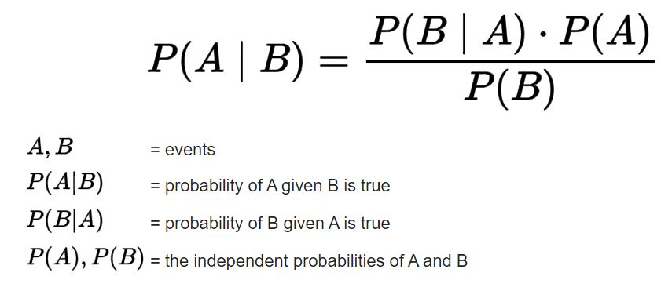
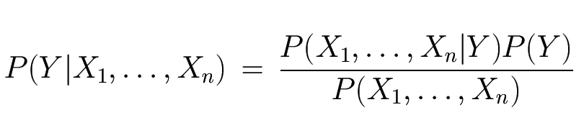
Bayes Theorem
Derived from conditional probability: likelihood of an event or outcome occurring, based on the occurrence of a previous event or outcome
Likelihood
Prior
Normalization Constant

Slide 3
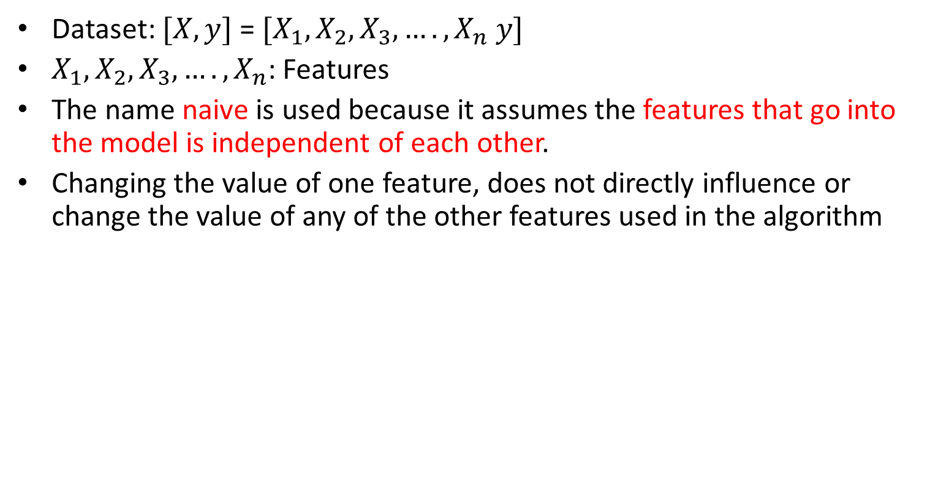
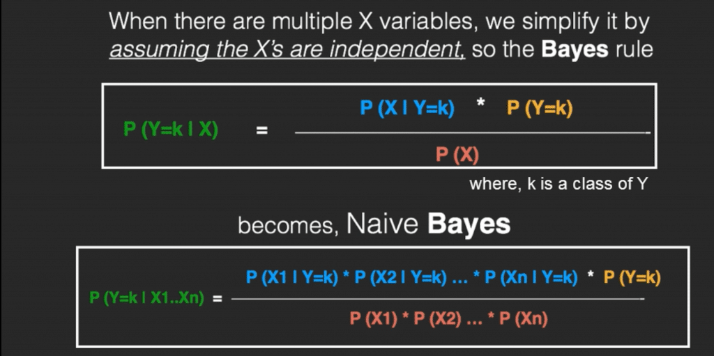
Naïve Bayes: innocent/unsophisticated

Slide 4
Example of the Naïve Bayes Classifier
Outlook feature
Temperature feature
 | Yes | No | P(Y) | P(N)
Sunny | 2 | 3 | P(S|Y) 2/9 | P(S|N) 3/5
Overcast | 4 | 0 | P(O|Y) 4/9 | P(0|N) 0/5
Rainy | 3 | 2 | P(R|Y) 3/9 | P(R|N) 2/5
Total | 9 | 5
Yes | 9 | P(Y) 9/14
No | 5 | P(N) 5/14
Total | 14
 | Yes | No | P(Y) | P(N)
Hot | 2 | 2 | P(H|Y) 2/9 | P(H|N) 2/5
Mild | 4 | 2 | P(M|Y) 4/9 | P(M|N) 2/5
Cool | 3 | 1 | P(C|Y) 3/9 | P(C|N) 1/5
Total | 9 | 5

Slide 5
Test data: Sunny, Hot: Features
Probability of Yes given {Sunny, Hot}= P(S|Y)×P(H|Y)×P(Y)= 2/9×2/9×9/14=2/63=0.031
Probability of No given {Sunny, Hot}= P(S|N)×P(H|N)×P(N)=3/5×2/5×5/14=3/35=0.085
Normalized: Probability of Yes given {Sunny, Hot}= 0.031/(0.031+0.085)=0.267
Normalized: Probability of Yes given {Sunny, Hot}= 0.085/(0.031+0.085)=0.733
Therefore, the prediction is No

Slide 6
Different types of Naïve Bayes
Multinomial Naive Bayes: Most common one. Suitable for discrete data
Gaussian Naive Bayes: Suitable for continuous data
Bernoulli Naive Bayes: Like MultinomialNB, this classifier is suitable for discrete data. The difference is that while MultinomialNB works with occurrence counts, BernoulliNB is designed for binary/Boolean features

